Slide 1
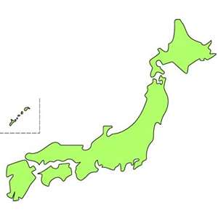
Access to Matsushima
④
Matsushima
Sendai Station
Sendai Station
②
③
Sendai Airport
Tokyo/Ueno
Narita
Airport
①
①Narita Airport→Tokyo St.・・・・・・・・・・・JR NaritaExpress (about 50minutes)
or Narita Airport→Ueno St.・・・・・・・・・SkyLiner (about 50min.)
②Tokyo St./Ueno St.→Sendai St.・・・・・・Tohoku Shinkansen (about 2hours)
③Sendai Airport→Sendai St.・・・・・・・・・・Sendai Airport Line(about 20min.)
④Sendai St.→Matsushima Kaigan St.・・・JR Senseki Line（about 30min.）
＊Free Shuttle Bus is available from Matsushima Kaisan St. to
Hotel Taikanso about 2 times per hour

